Slide 1


MAHENDRA ENGINEERING COLLEGE
(AUTONOMOUS)
DEPARTMENT OF COMPUTER SCIENCE & ENGINEERING
Detection and Classification of Skin Cancer Lesions Using Tensor Flow
PROJECT VIVA VOCE
DATE:20.03.2019
Prepared By: Guided By:
Sakthivel.C (Reg.No.: 151031068)
BE – Final Year / VIII Semester Ms. P. Thilagavathi, M.E.,
Assistant Professor
Notes:
Title

Slide 2
INTRODUCTION:
Melanoma is one of the most deadly types of all skin cancers in humans that appear on the skin as pigmented moles or marks.
Melanoma occurs when something goes awry in the melanin-producing cells (melanocytes) that give color to your skin.
Some of the risk factors of Melanoma are fair skin, a history of sunburn, genetic factors, weakened immune system, tanning beds and excessive ultraviolet light exposure.
Melanoma is more than 20 times more common in whites than in African Americans. Overall, the lifetime risk of getting melanoma is about 2.6% (1 in 38) for whites, 0.1% (1 in 1,000) for blacks, and 0.58% (1 in 172) for Hispanics.
The objective of this project is to detect the malignant lesions using Machine learning.

Slide 3
ABSTRACT:
The purpose of this project is to create a tool that considering the image of a mole, can calculate the probability that a mole can be malign.
Skin cancer is a common disease that affect a big amount of peoples. Some facts about skin cancer:
Every year there are more new cases of skin cancer than the combined incidence of cancers of the breast, prostate, lung and colon.
An estimated 87,110 new cases of invasive melanoma will be diagnosed in the U.S. in 2017.
The estimated 5-year survival rate for patients whose melanoma is detected early is about 98 percent in the U.S. The survival rate falls to 62 percent when the disease reaches the lymph nodes, and 18 percent when the disease metastasizes to distant organs.
Early detection is critical!

Slide 4
EXISTING SYSTEM:
Existing systems are capable of detecting skin cancer cells efficiently.
Existing systms are used by professionals.
Existing system using the images and CSV based file to train data.
The current systems are using tensorflow in order to understand the given image and then detect the cancer cells.

Slide 5
LIMITATIONS:
Lack of proper classification of cancer lesions.
They lack the effectiveness because of not using proper neural network training methodology.
Based on very less input datasets.

Slide 6
PROPOSED SYSTEM:
Image Preprocessing:
3. Crop images: Automatic or manual Crop
4. Other to define later in order to improve model quality
CNN Model:
The idea is to develop a simple CNN model from scratch, and evaluate the performance to set a baseline.

Slide 7
PROPOSED SYSTEM:
The following steps to improve the model are:
1. Data augmentation: Rotations, noising, scaling to avoid overfitting.
2. Transferred Learning: Using a pre-trained network construct some additional layer at the end to fine tuning our model.(VGG-16,U-NET)
3. Fine tuning

Slide 8
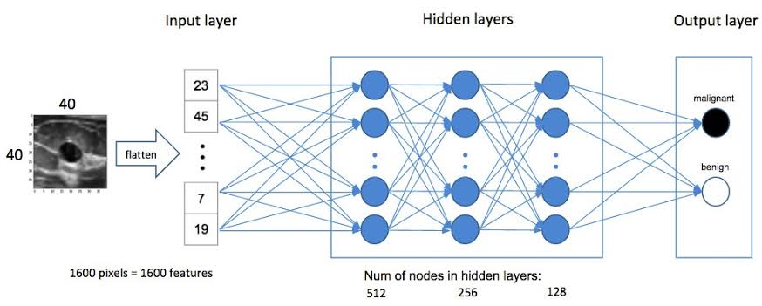
SYSTEM ARCHITECTURE:

Slide 9
LIST OF MODULES:
1. Data Acquisition
2. Initial Preprocessing and visualizations
3. First Model Construction and tuning
4. Model Optimization I (Data augmentation)
5. Model Optimization II (Transferred learning)
6. Model Optimization III (Fine Tuning)

Slide 10
MODULE DESCRIPTION:
Data Acquisition
Data Acquistion is the process of collecting data for training.
Training will be done by using ISIC datasets.
Totally there are more than 12000 images to train the model.

Slide 11
CONT…
FIRST MODEL CONSTRUCTION AND TUNING
Training the model based on the ISIC dataset
The first set of trainig will be given on 4000 steps
Once after giving the command we need to wait for the training procedure to complete with tensorflow

Slide 12
CONT…
MODEL OPTIMIZATION I (DATA AUGMENTATION)
Data augmentation is a way of creating new ‘data’ with different orientations. The benefits of this are two fold, the first being the ability to generate ‘more data’ from limited data and secondly it prevents over fitting.
The data provided to the model will be reused to train the model iteratively to increase the accuracy and reduce overfitting.

Slide 13
CONT…
MODEL OPTIMIZATION II (TRANSFERRED LEARNING)
Transfer learning is a research problem in machine learning that focuses on storing knowledge gained while solving one problem and applying it to a different but related problem.
The model will store the result of anything new provided to it in graph.pb files and use it for future instamces.

Slide 14
CONT…
MODEL OPTIMIZATION III (FINE TUNING)
Fine tuning refers to the process of making small modifications to improve or optimize an outcome. Generally, fine tuning seeks to increase the effectiveness or efficiency of a process or function.
Once the whole training and optimization process is done we can fine tune the model based on the results we get from it.
The model can be further optimized to get more desirable results.

Slide 15
CONCLUSION
The project has proposed a Deep Learning solution for assisting dermatologists during the diagnosis of skin lesions.
More specifically, it has investigated how a previous semantic segmentation of the skin lesion improves the performance of a fine-tuned convolutional neural network model approach for a 2-class classifier for early melanoma
The proposed approach achieves promising results, most notably, a Jaccard value of 91.76%.

Slide 16
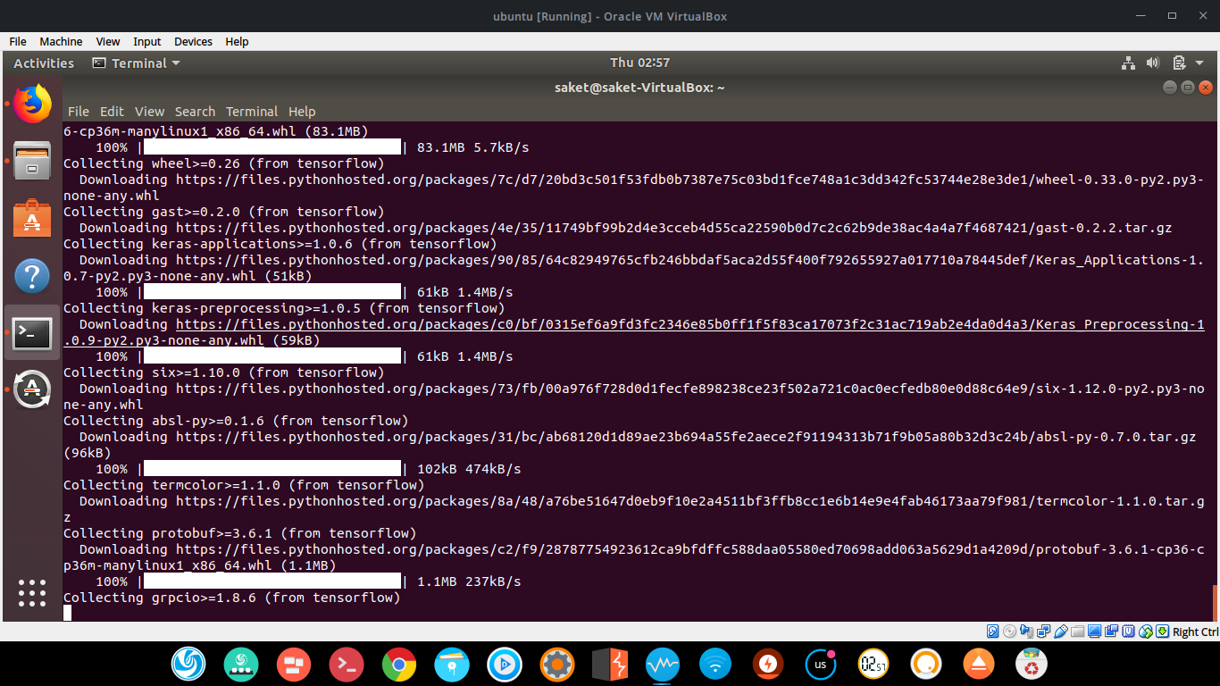
Installing tensorflow

Slide 17
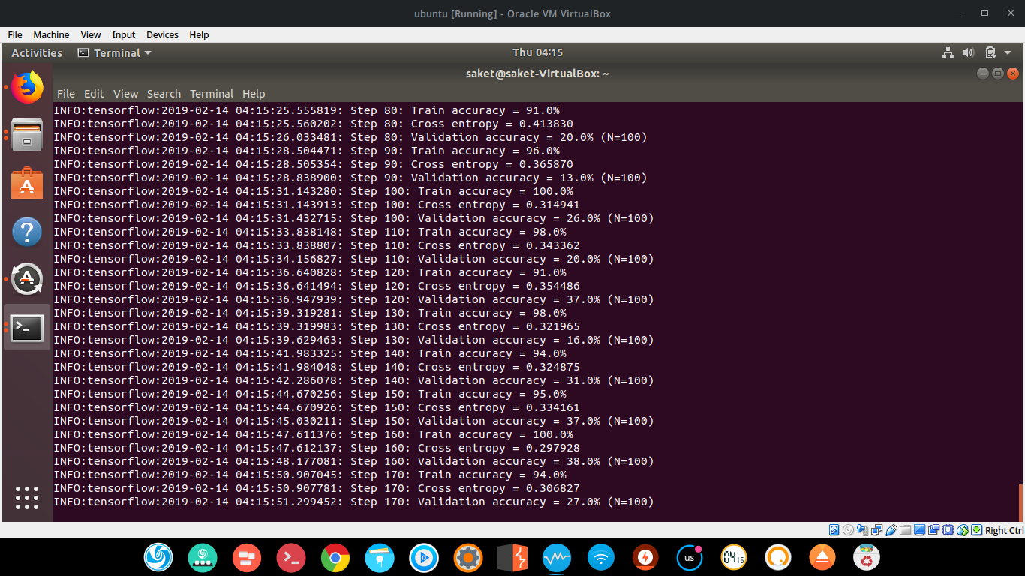
Training Started

Slide 18
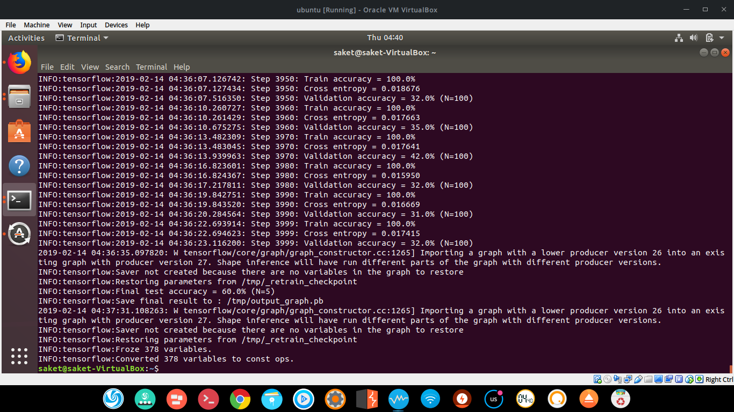
Training finished

Slide 19

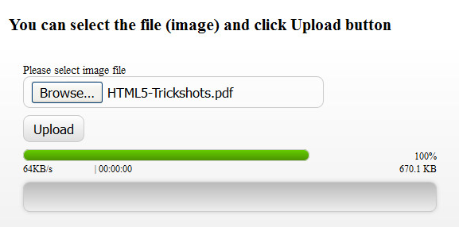
Screen shots:
Image Upload

Slide 20

REFERENCES:
[1]. http://www.skincancer.org
[2]. http://www.medicinenet.com
[3]. Haykin, Simon. Neural networks: a comprehensive foundation. Prentice Hall PTR, 1994
[4]. Kopf, Alfred W. "Prevention and early detection of skin cancer/melanoma." Cancer 62.S1
[5]. Hoshyar, Azadeh Noori, Adel Al-Jumaily, and Riza Sulaiman. "Review on automatic early skin cancer detection." Computer Science and Service System (CSSS), 2011 International Conference on. IEEE, 2011.
[6]. Sonali Raghunath Jadhav, D.K.Kamat. ”Segmentation based detection of skin cancer” IRF international conference, 20- july-2014
[7]. Lau, Ho Tak, and Adel Al-Jumaily. "Automatically Early Detection of Skin Cancer: Study Based on Nueral Netwok Classification." Soft Computing and Pattern Recognition, 2009. SOCPAR'09. International Conference of. IEEE, 2009.

Slide 21
Thank you

